Slide 1
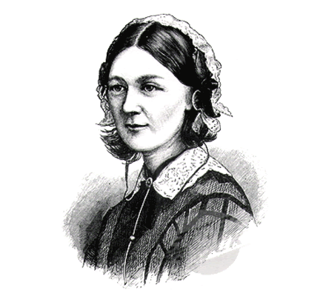
Florence nightingale
1820-1910
«THE LADY WITH THE LAMP»

Slide 2
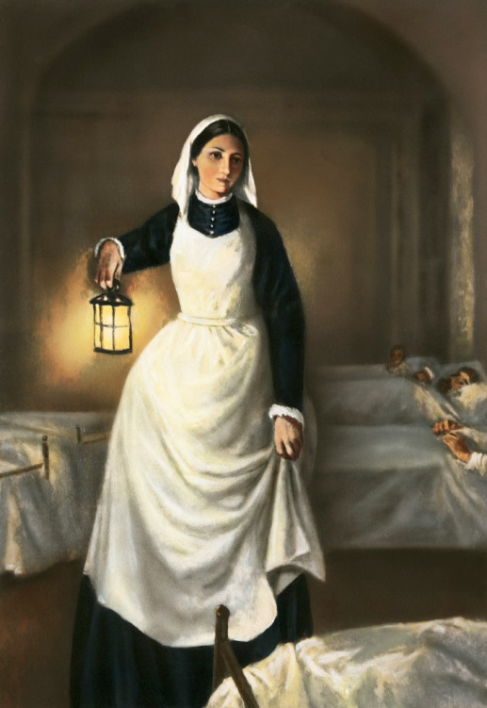
EARLY LIFE
Florence Nightingale was born in Florence in 1820;
She come from to a very rich English family;
Her father provided her with reputable education which was uncommon for a Victorian woman;
She soon recognized the shortcomings of the nursing profession as it was praticed at the time;

Slide 3
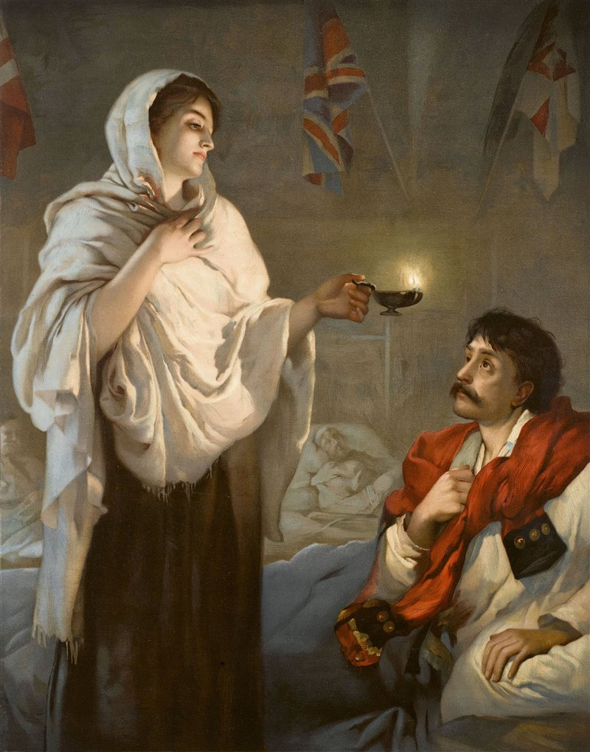
HER DREAM…
When she was annunced that she wanted to become a nurse, her parents tried to persuade e her not to leave;
Florence refused to give up her dream of helping poor and sick people and convinced them to let her leave for the crimea:

Slide 4
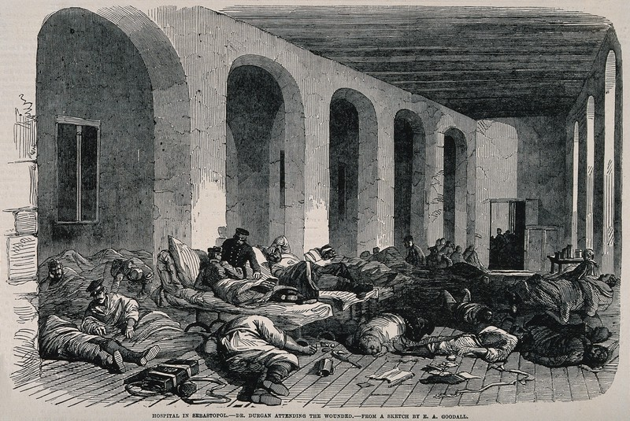
THE CRIMEA WAR
In the 1854 the Crimea War had brocken out and many british soldiers were dying because of entreated wounds;
She was founder of modern nursing care;
International Nursing Day, observed every year on May 12, commemorates its birth and celebrates the important role of nurses in health care;

Slide 5
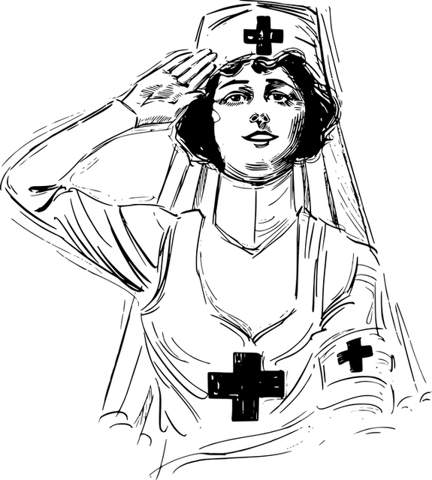
«The first requirement of a hospital should be to not harm one’s patients»
Florence Nightingale
By Pietradura Manuela

