Slide 1
Florence Nightingale Museum

Slide 2
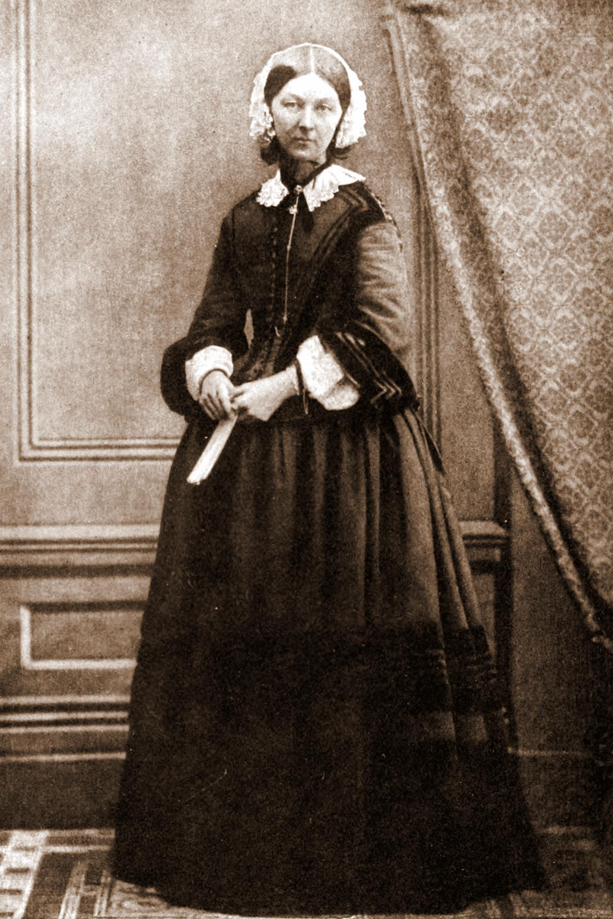
Florence Nightingale
She was born on 12th May 1820 and her birthday is also International Nurses Day because she is considered the mother of modern nursing.
She gave nursing a favourable reputation and became an icon of Victorian culture.
She was called “lady of the lamp” because she worked through the night caring for the sick.
In 1989 was founded a museum in her honor: the “Florence Nightingale Museum”.

Slide 3
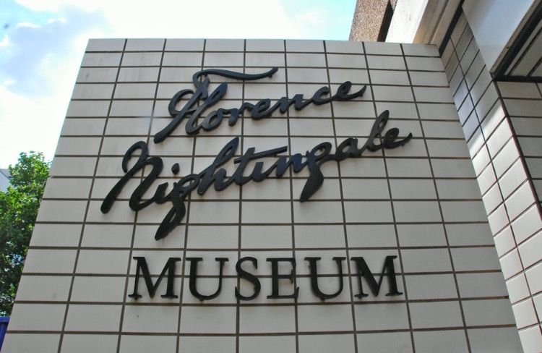
The Florence Nightingale Museum is located at St Thomas' Hospital, which faces the Palace of Westminster across the River Thames in South Bank, central London, England.
In 1860 Nightingale founded the Nightingale Training School for nurses at St. Thomas' Hospital and the museum is located on this site.

Slide 4
The new museum is designed around three pavilions that tell her story.
The Gilded Cage tells the story of Nightingale's privileged childhood and her struggle against stifling social conventions.
The Calling shows how Nightingale and her team coped with the crisis in the military hospitals where the legend of the lady with the lamp was born.
Reform and Inspire shows the other side of Nightingale, the reformer who campaigned tirelessly for health reform at home and abroad.
A stained glass window of Nightingale, on display at the museum

Slide 5
The Collection include the writing slate Nightingale used as a child, her pet owl Athena and Nightingale's medicine chest, which she took with her to the Crimean.
The museum displays a rare Register of Nurses that lists women who served under Nightingale in the military hospitals in Turkey and the Crimean.

Slide 6
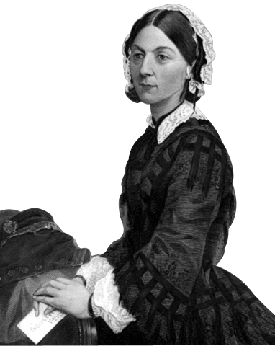
There is also a resource centre which is open by appointment to students, academics and other researchers, who may use the museum's collections, books and documents related to Florence Nightingale.
The museum is a member of the London Museums of Health & Medicine.

Slide 7
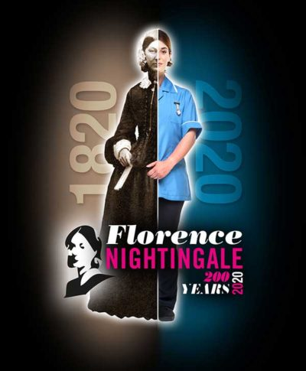
“I am of certain convinced that the greatest heroes are those who do their duty in the daily grind.“

