Slide 1
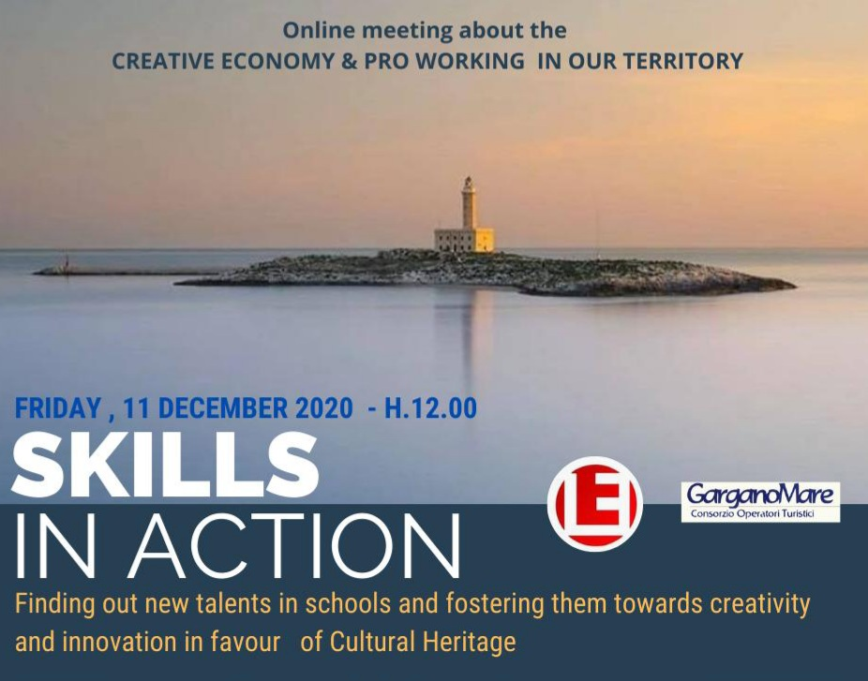

Slide 2
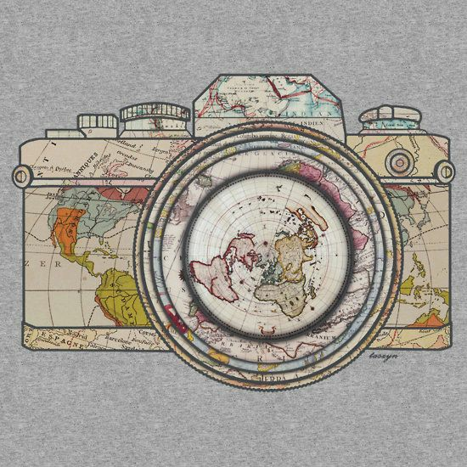
Why this meeting?
A chance to showcase students’ skills
An opportunity to meet & speak to some experts and lovers of our territory
A creative way to study, to create new cultural content, to tell the story of what they see and do.

Slide 3
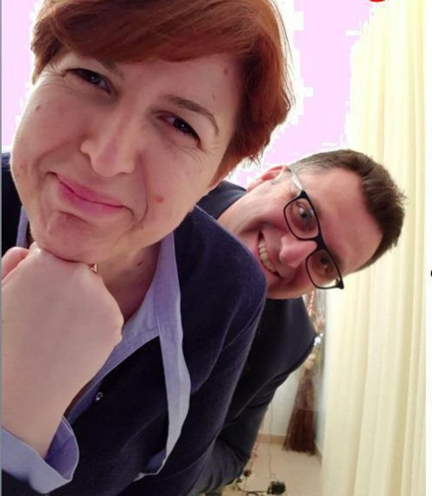
Who are the experts in today’s online meeting?
Dott.ssa Maria Nobiletti,
Presidente Consorzio
“Gargano Mare”.
Dott. Stefano Iorio,
digital coach
Blog “Garganoismore.

Slide 4
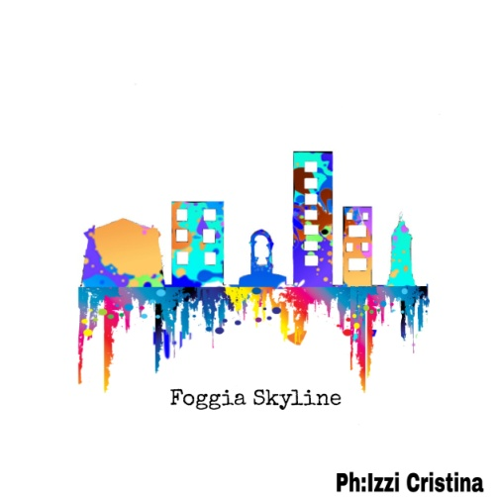
Who are the students involved?
The students of the Graphic Design Course are artists, illustrators, typographers, photographers, makers of diagrams and advertisements.
They are observers, thinkers, and creators. They are graphic designers. They love what they do !

Slide 5
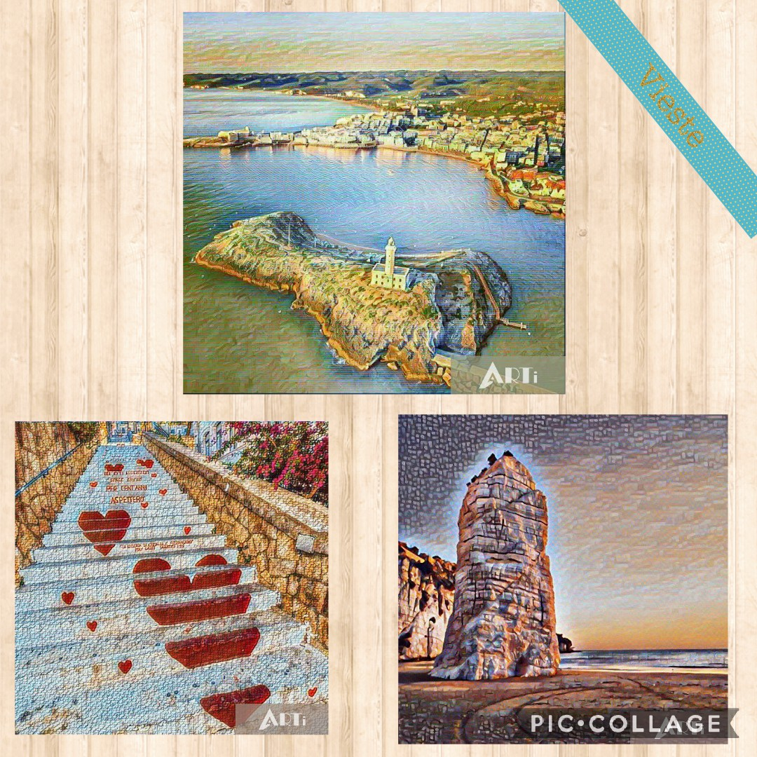
PROMOTING VIESTE CREATIVELY
Souvenirs don't have to be boring!
Project idea: To Home from Vieste.

Slide 6
Evaluation criteria: (CRITERI DI VALUTAZIONE)
Consistency with the assignment (coerenza)
Appeal of the design (attrazione)
Clarity of the idea (esposizione chiara dell’idea)
Use of colours and shapes (uso di colori e forme)
Every element will be evaluated from 1 to 5 (ogni elemento potrà ricevere da 1 a 5 punti)

Slide 7
TO HOME FROM VIESTE

Slide 8
TO HOME FROM VIESTE

Slide 9
TO HOME FROM VIESTE

Slide 10
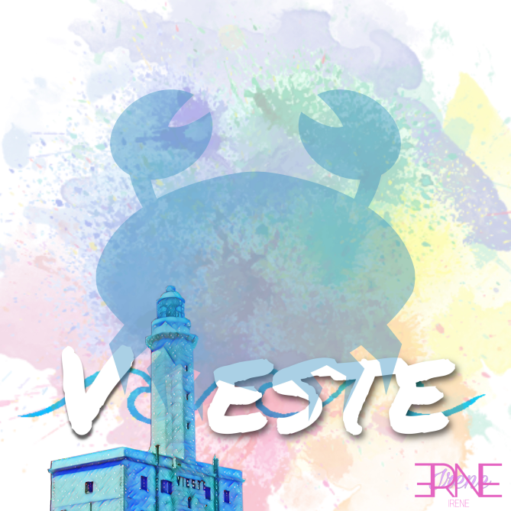
TO HOME FROM VIESTE

Slide 11
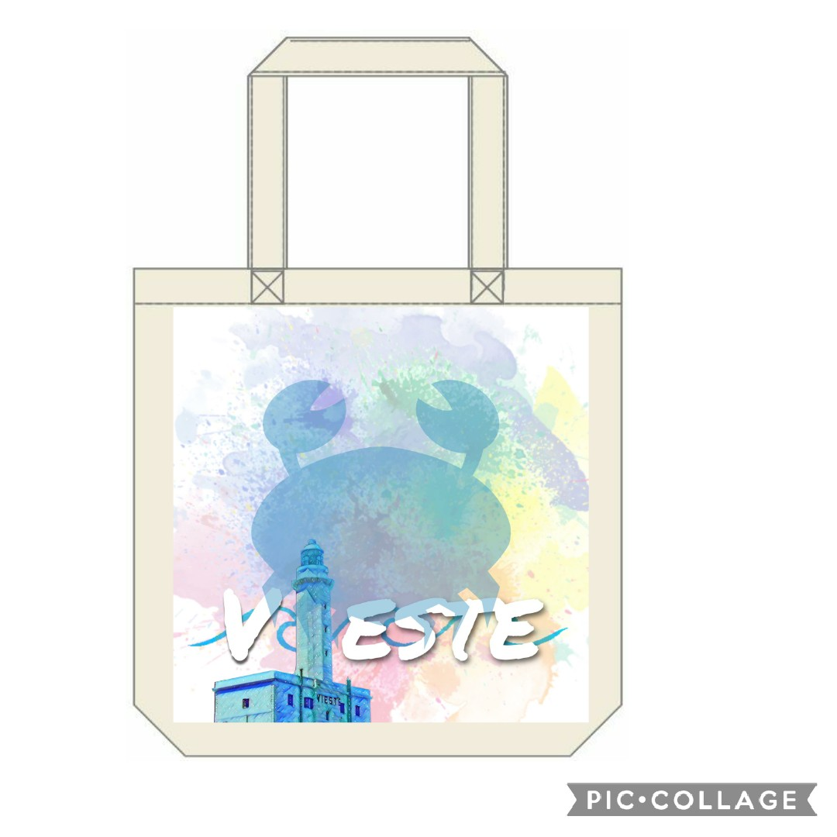
TO HOME FROM VIESTE

Slide 12
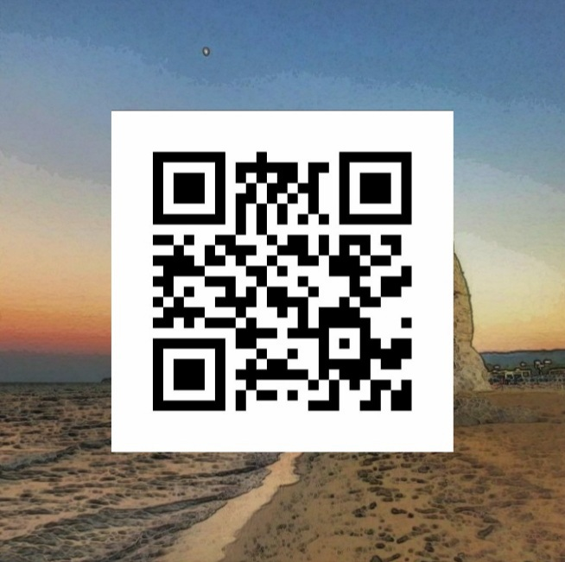
TO HOME FROM VIESTE
Link: https://www.youtube.com/watch?v=hdOw1na3m4c

Slide 13
TO HOME FROM VIESTE

Slide 14
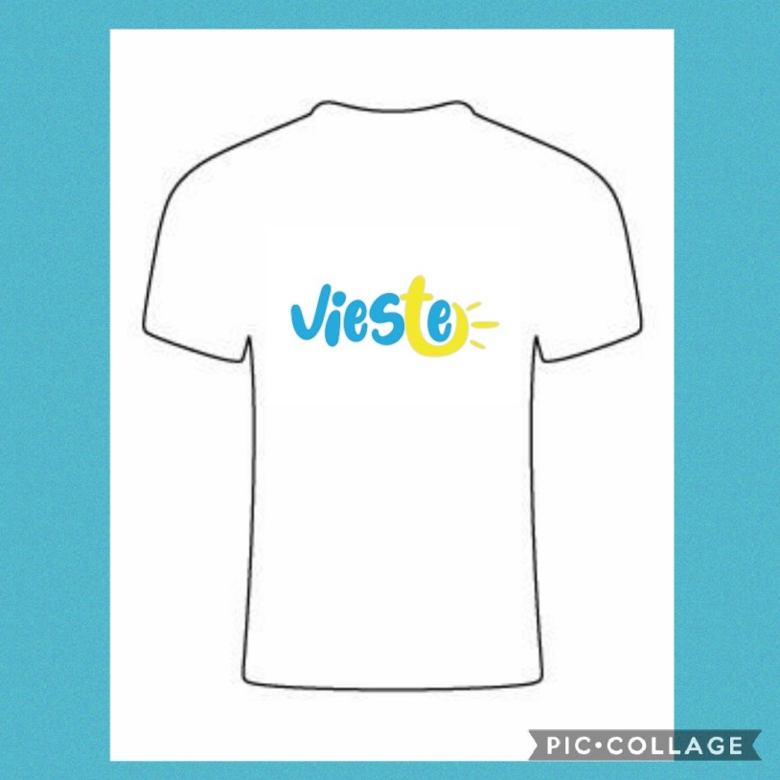
TO HOME FROM VIESTE

Slide 15
TO HOME FROM VIESTE

Slide 16
TO HOME FROM VIESTE

Slide 17
TO HOME FROM VIESTE

Slide 18
TO HOME FROM VIESTE

Slide 19
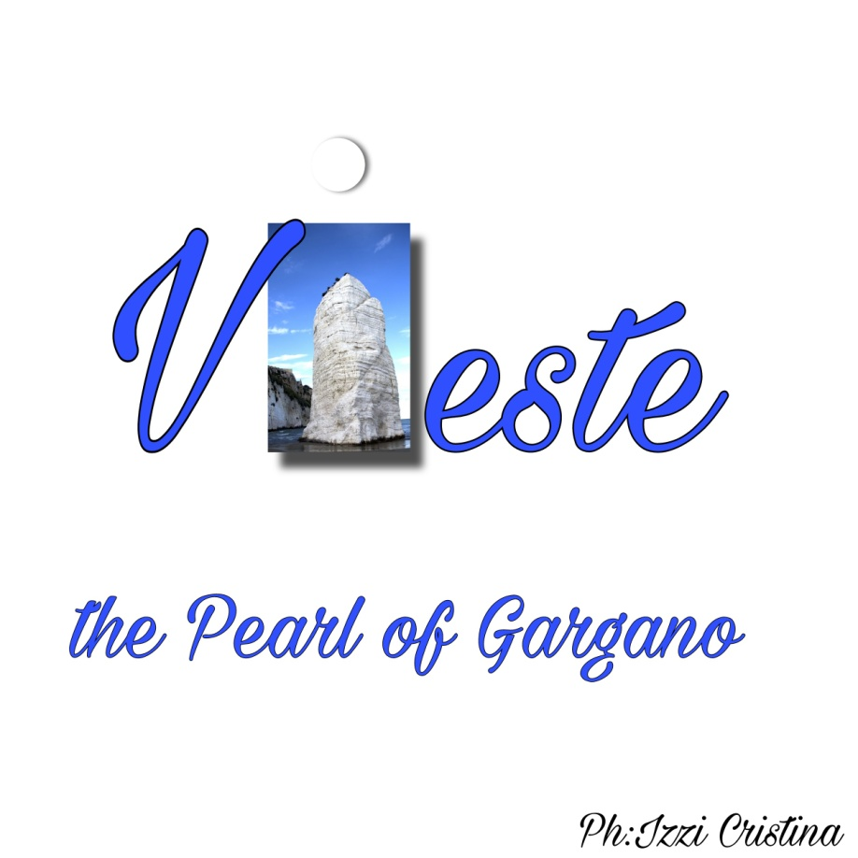
TO HOME FROM VIESTE

Slide 20
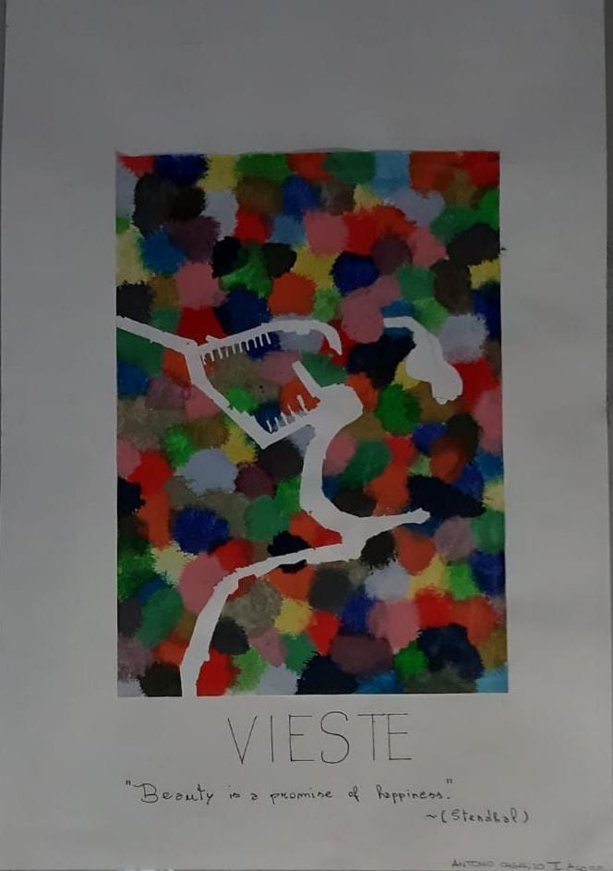
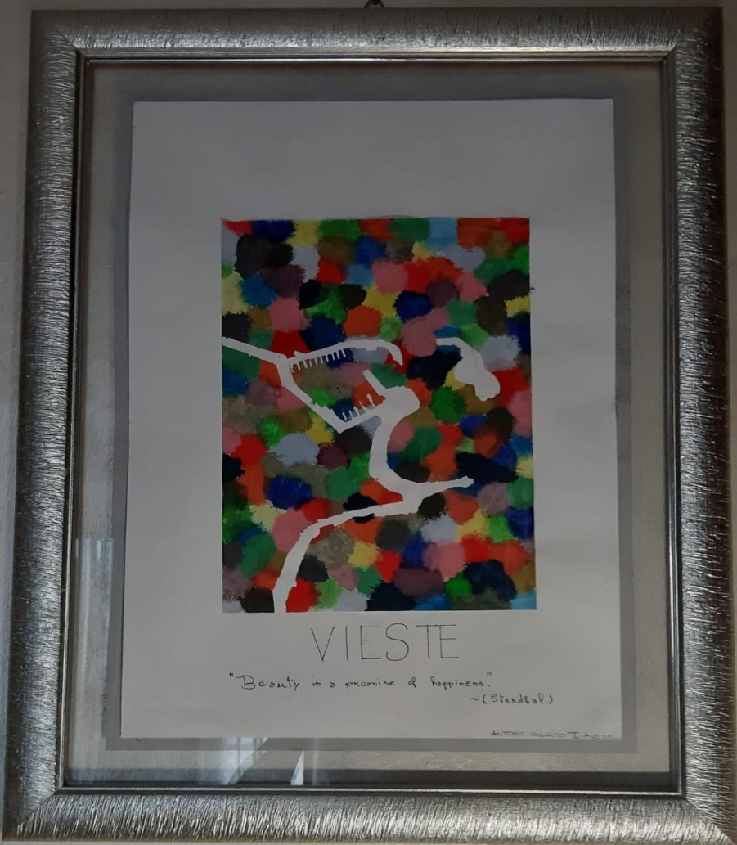
TO HOME FROM VIESTE
Illustrated Map:
Beauty is
a promise of
happiness
(Stendhal)

Slide 21
