Slide 1
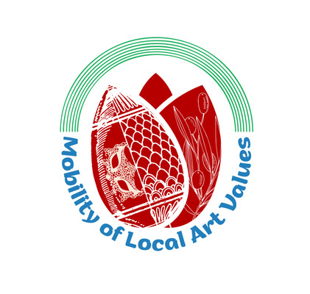
Mobility of Local Art Values
eTwinning project 2021-2022
4 partners involved:
Turkey, Croatia, Italy, Greece

Slide 2
About the project
This project was an opportunity for the 4 European countries to promote their local arts to their partners.
Each month, the 4 countries involved in the project recognized the artistic value of another country, applying it with their students.
When it was their turn, each country told the other partners about their own local art value. Thus, it was a gorgeous way to meet new people and discover different art practices.

Slide 3
Aims
Expressing intercultural communication with art.
Recognizing and applying the artistic values of various countries in Europe
Using art as a form of expression
Ensuring cooperation between European countries
Creating tolerant and respectful communities
Working collaboratively with different communities
Giving students with special needs a sense of achievement.

Slide 4
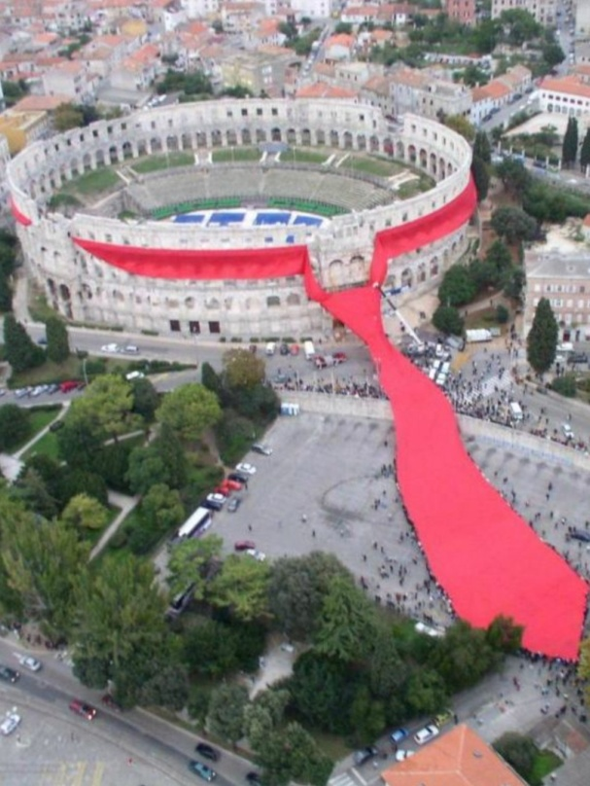
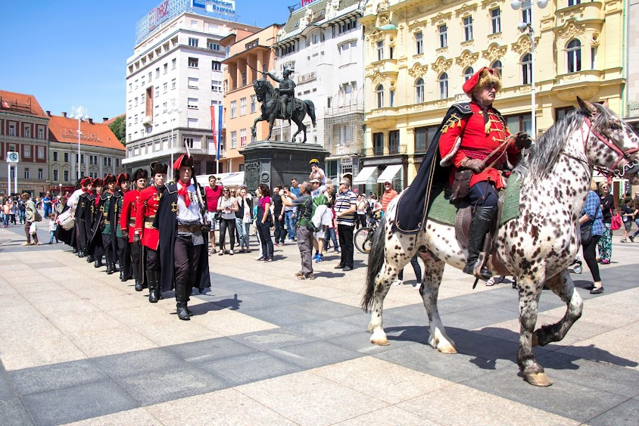
Work process
NOVEMBER: Croatia Art Month
Art value exalted : the Croatian Tie

Slide 5
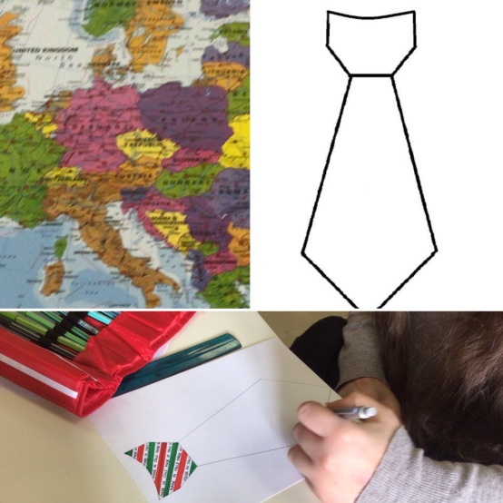
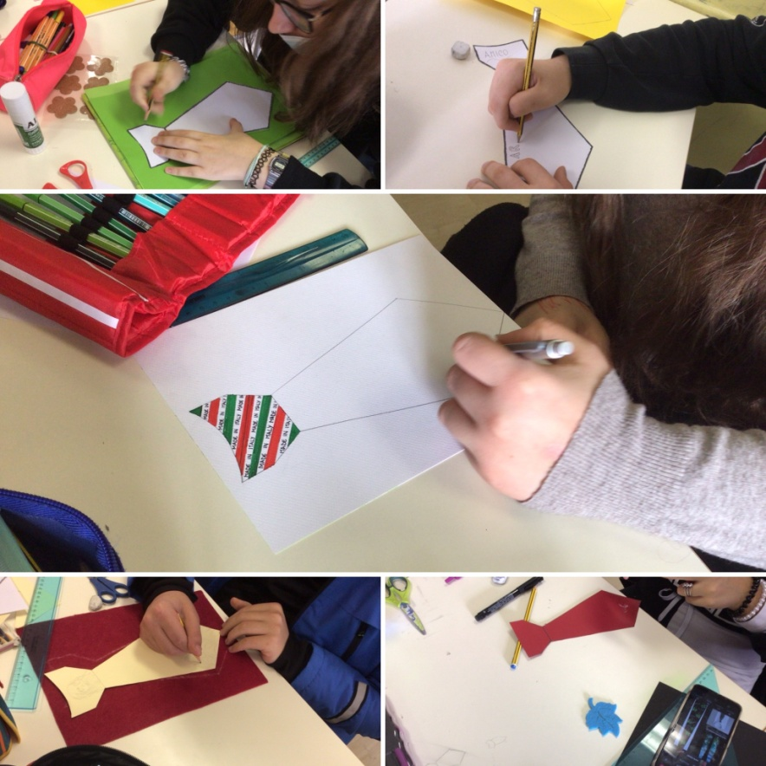
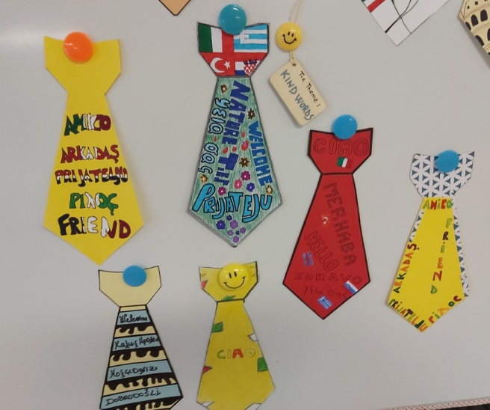
The Italian students’ involvement

Slide 6
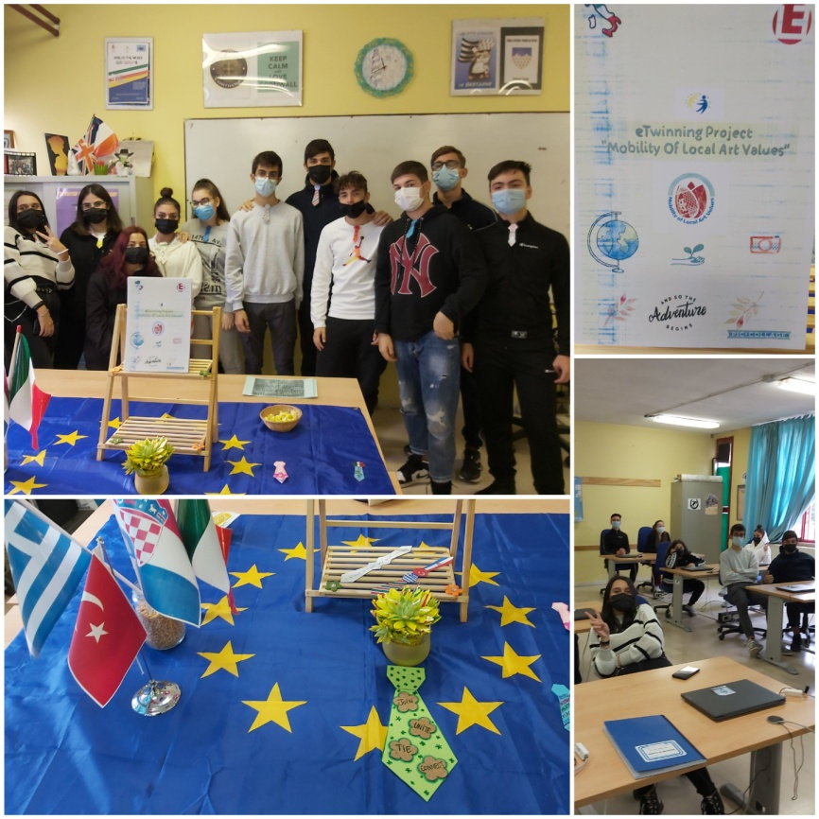
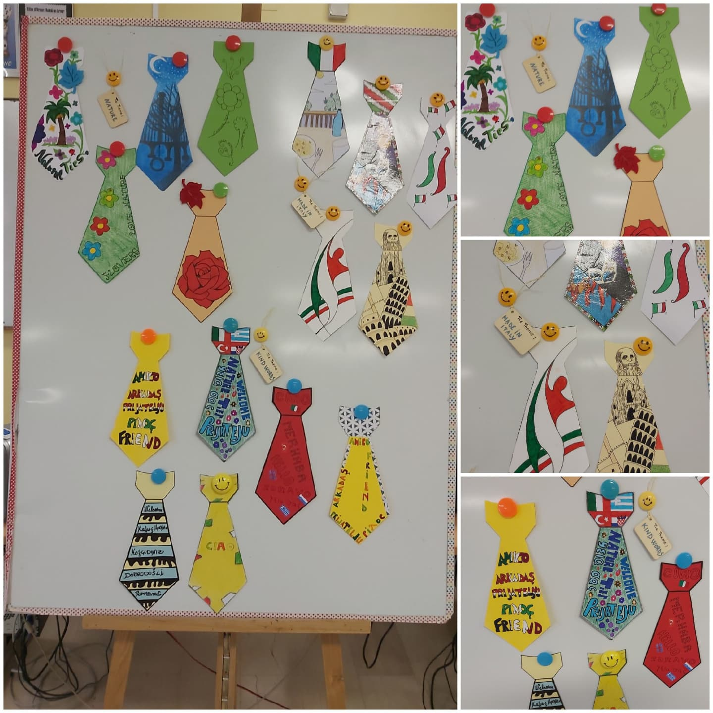
A tribute to Croatia by the Italian students
Event organized in the language lab on Nov.19, 2021:

Slide 7
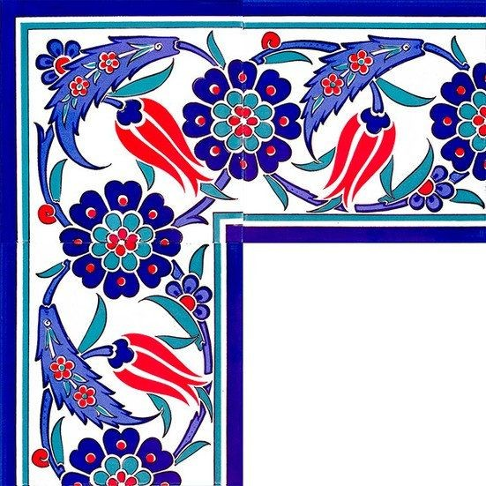
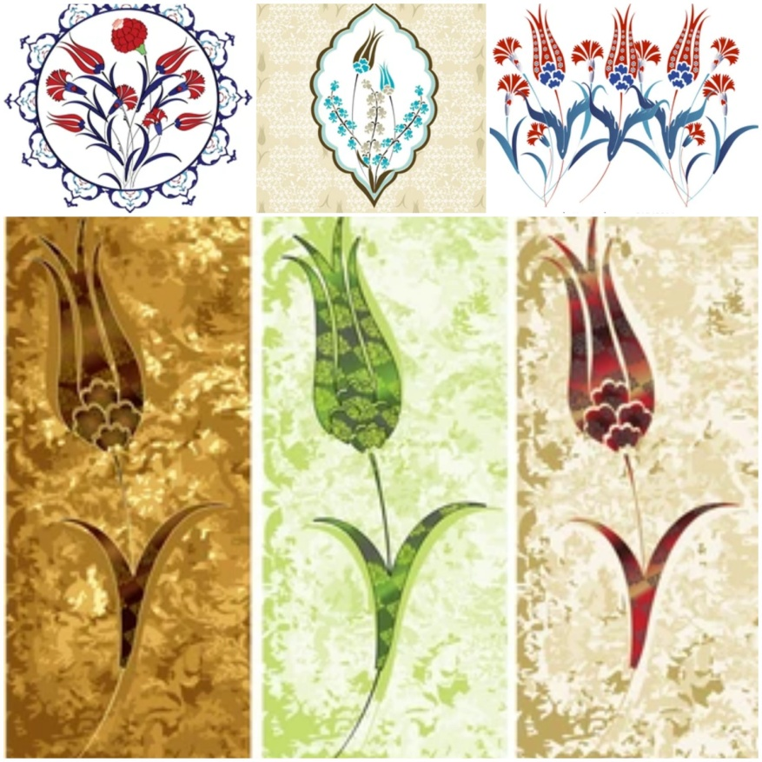
December: Turkey Art Month
Art Value exalted: Tiles

Slide 8
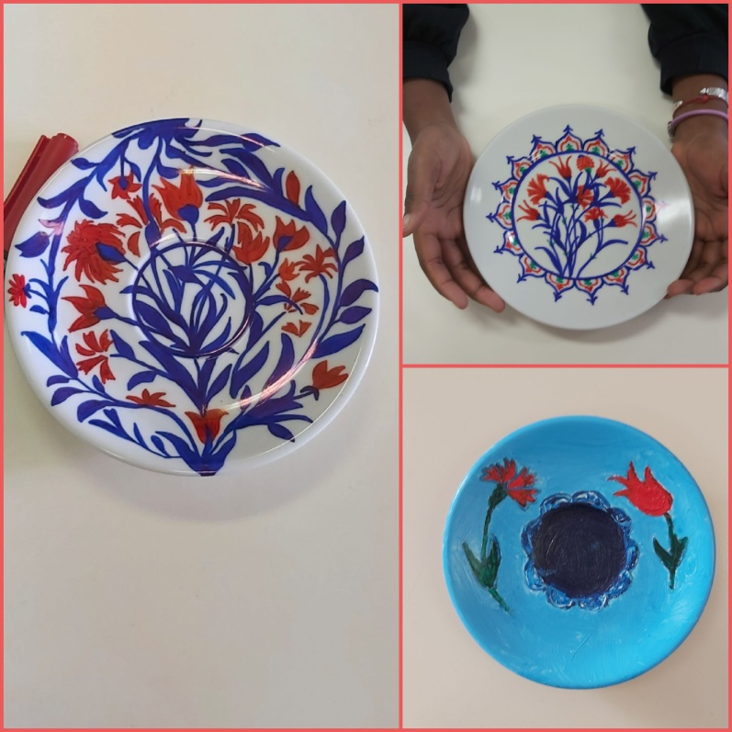
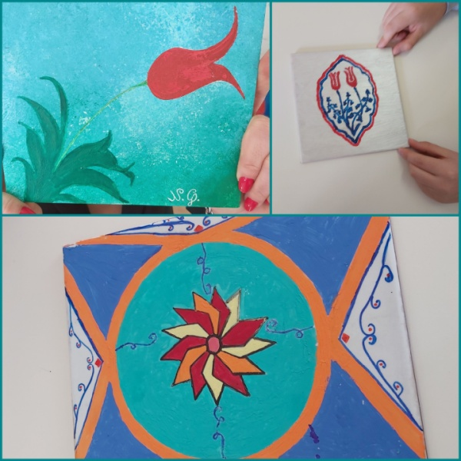
The Italian students’ involvement

Slide 9
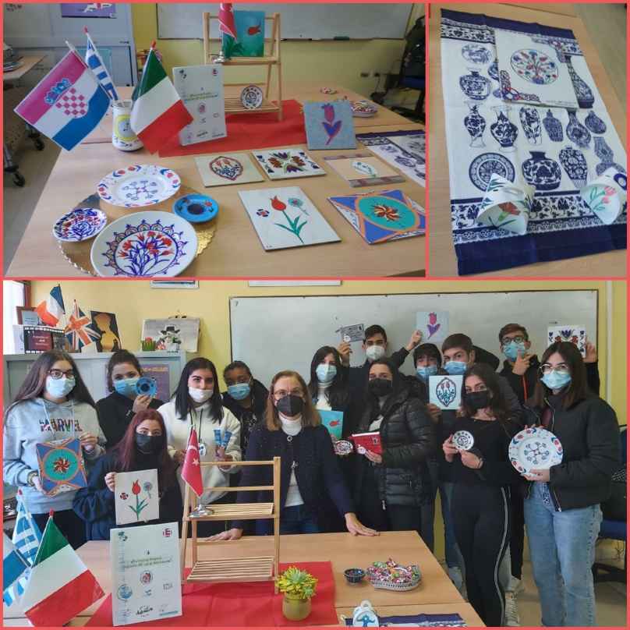
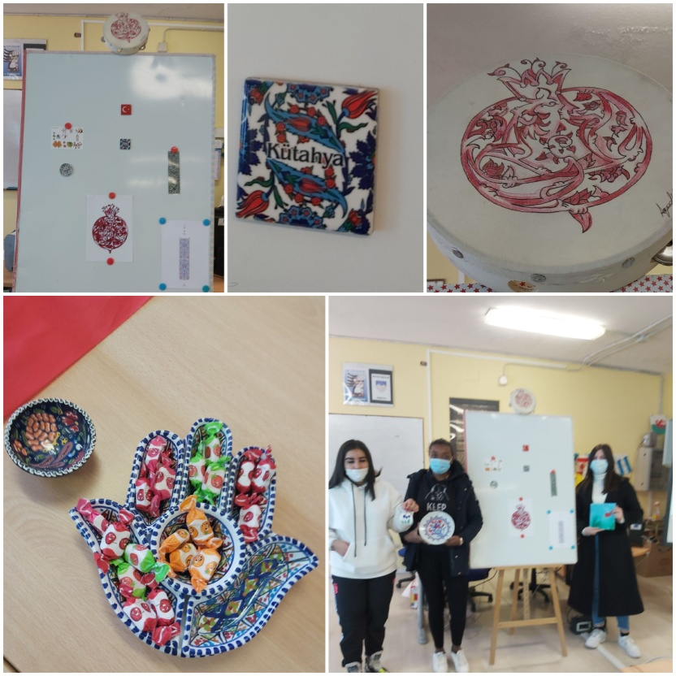
A tribute to Turkey by the Italian students
Event organized in the language lab on Dec.20, 2021:

Slide 10
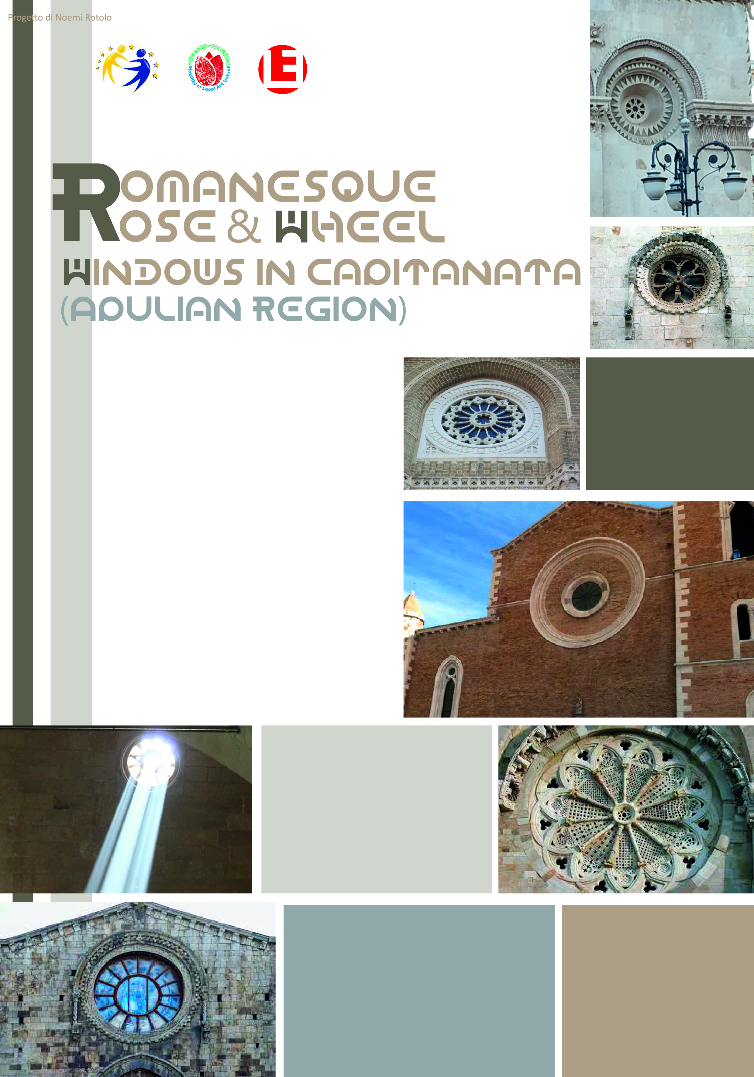
January: Italy Art Month
Art Value exalted: Apulian Romanesque Rose Windows

Slide 11
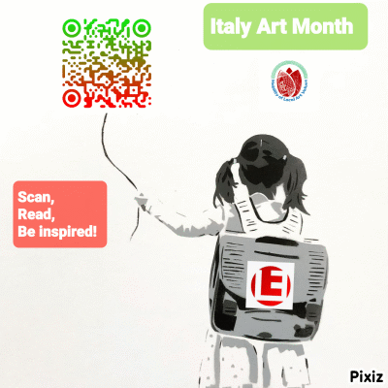
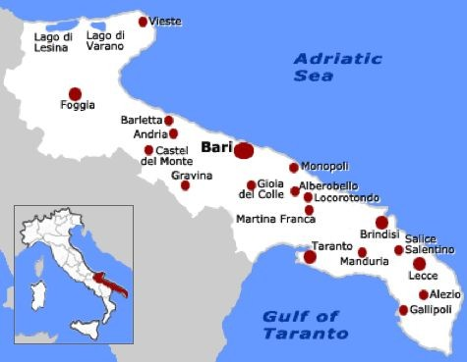
The Italian students’ involvement

Slide 12
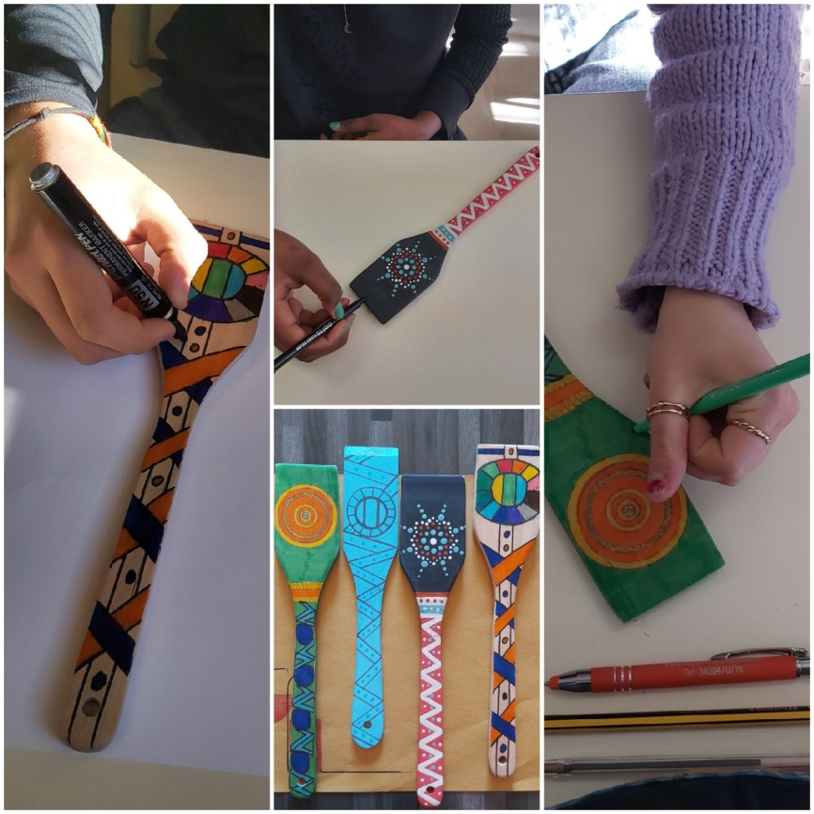
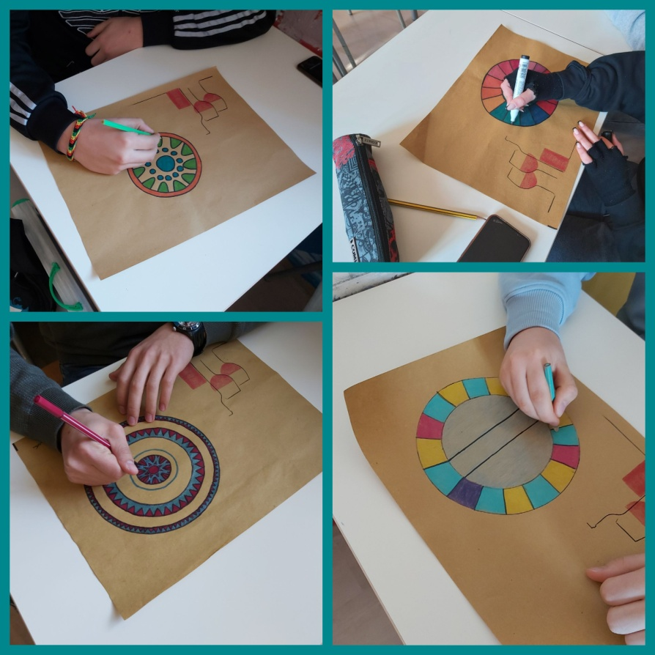
The Italian students’ involvement

Slide 13
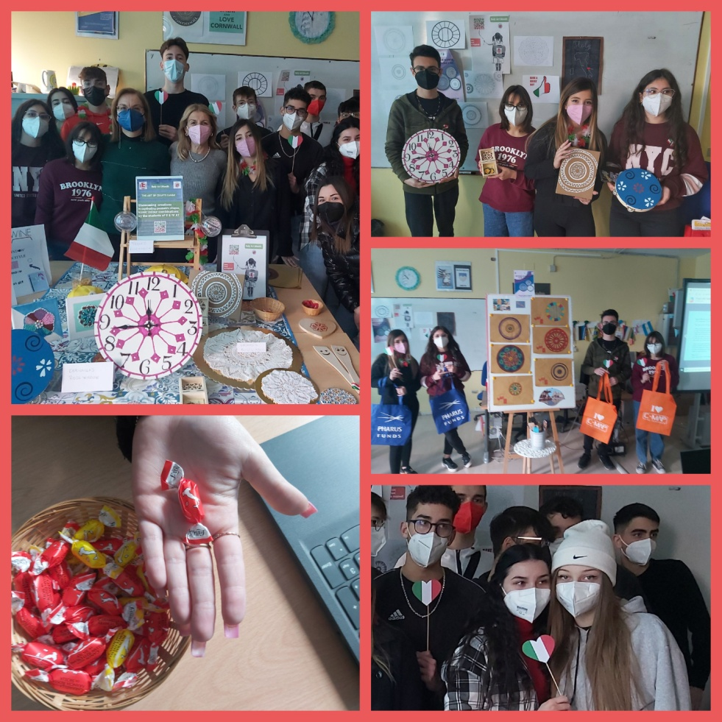
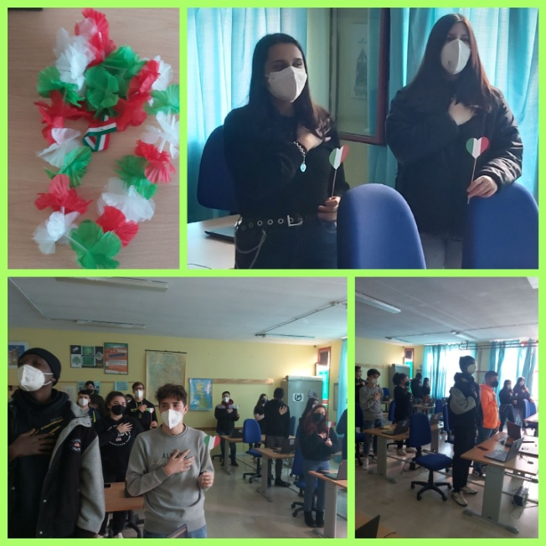
Celebrating Italy Art Month January 27, 2022

Slide 14
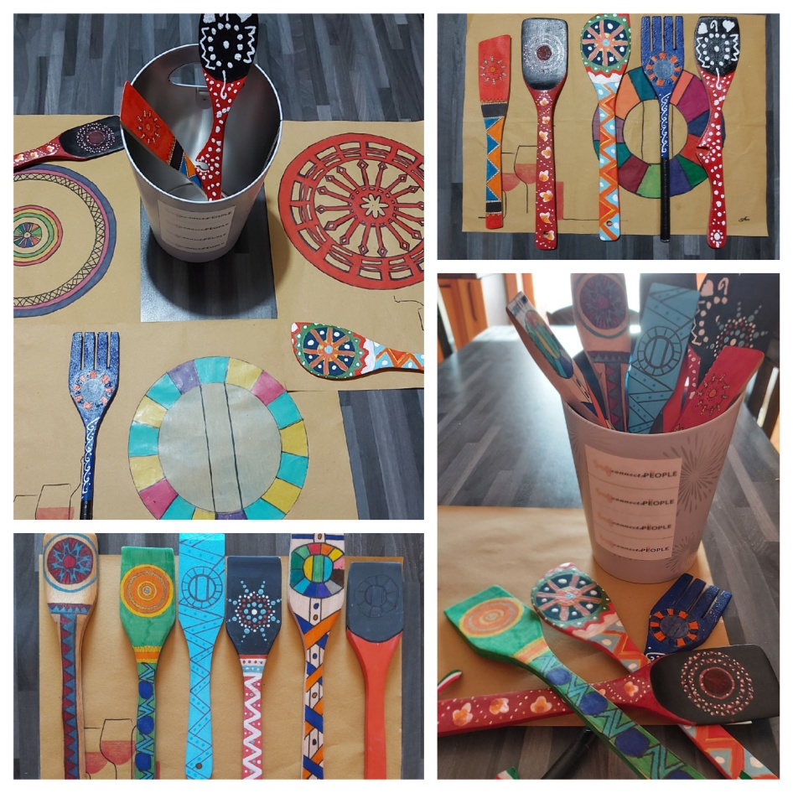
Celebrating Italy Art Month January 27, 2022

Slide 15
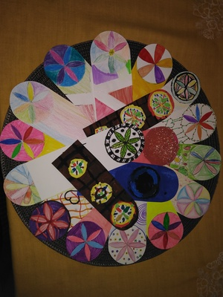
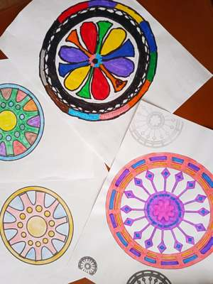
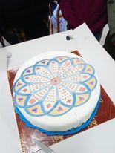
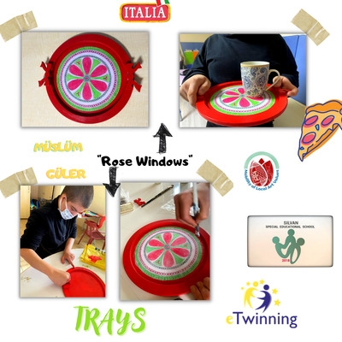
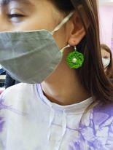
The partners’ involvement in Italy Art Month

Slide 16
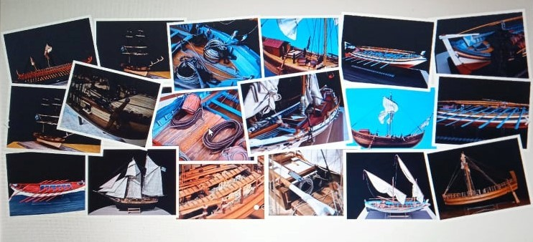
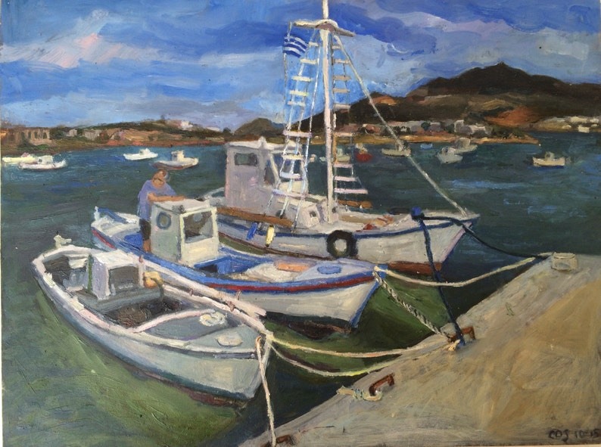
February: Greece Art Month
Art Value exalted: Greek traditional shipbuilding-Trechantiri

Slide 17
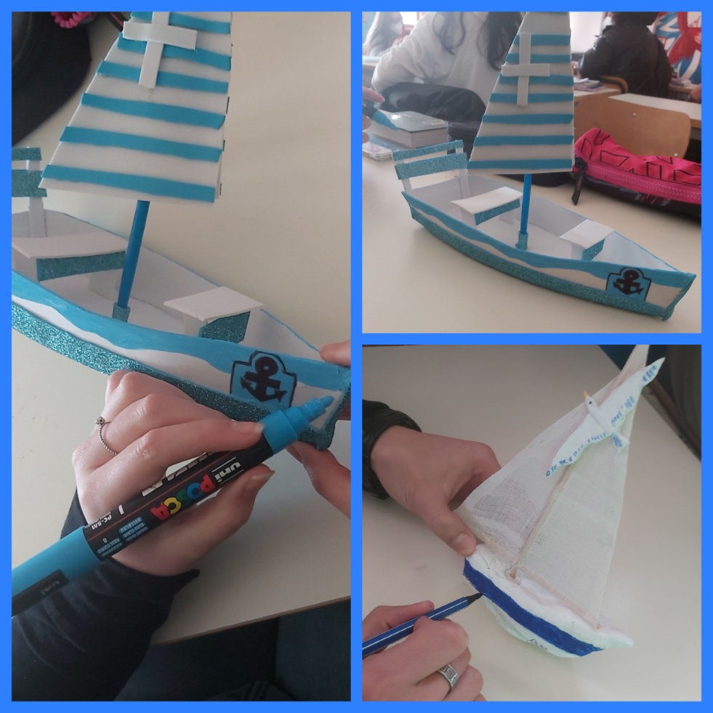
The Italian students’ involvement

Slide 18
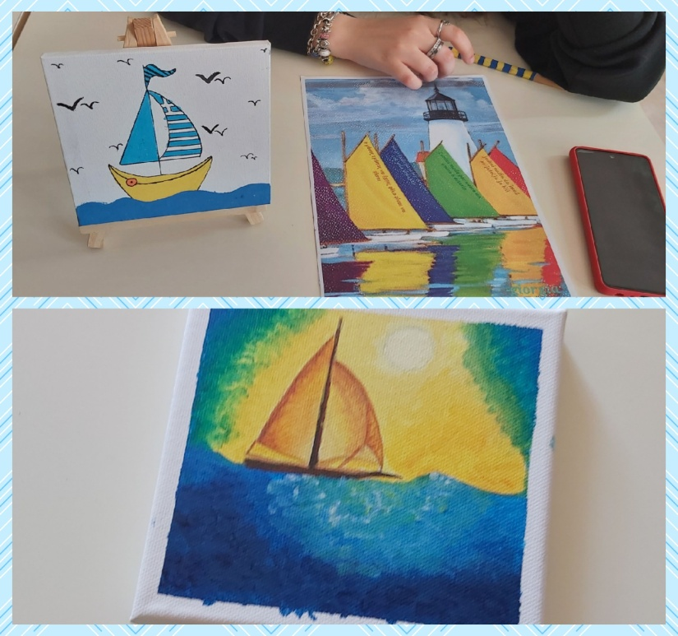
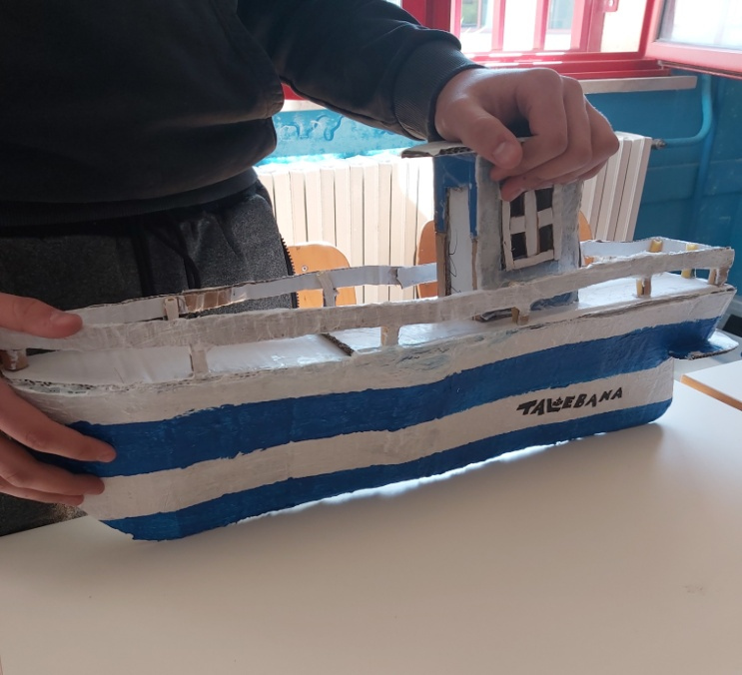

Slide 19
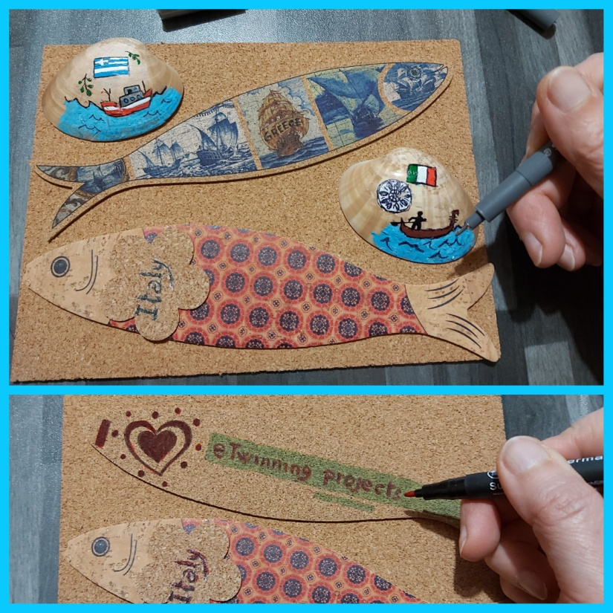
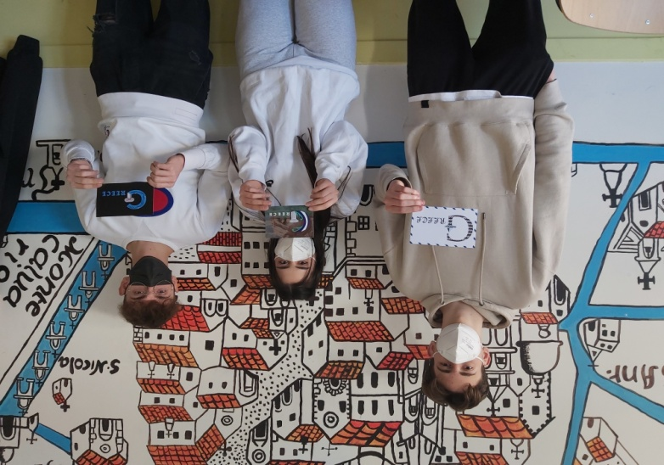

Slide 20
A tribute to Greece by the Italian students
Event organized in the language lab on Feb.28, 2022:

Slide 21
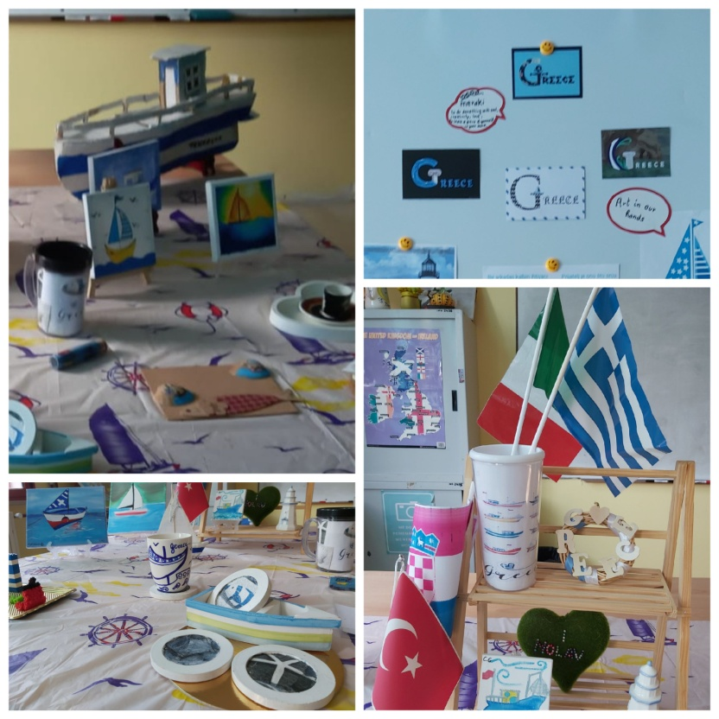
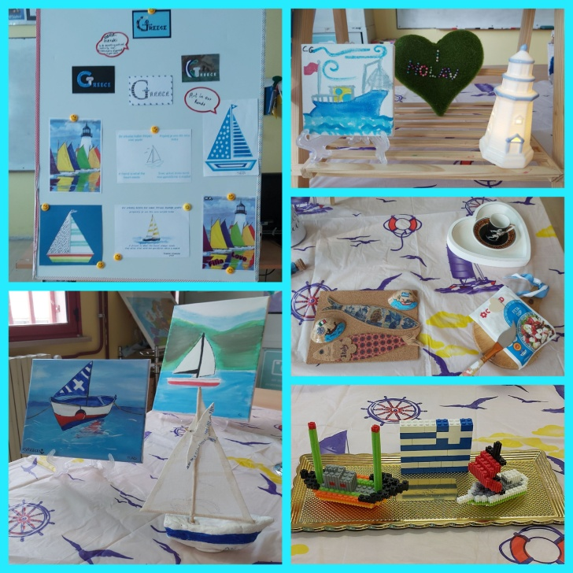

Slide 22
Why is Art important?

Slide 23
Art connects people!

Slide 24
Unity in Diversity!

Slide 25
Project Results:
4 different European countries getting to know each other
Learning artistic values in 4 different European countries
Widespread use of English as a secondary language
Establishment of new friendships
Increasing tolerance and respect
Breaking the prejudice against art

Slide 26
THANK YOU FOR YOUR ATTENTION!
Powerpoint presentation by:
Ms Paola Iorio – English Teacher (CLIL )
The Italian students of II & IV AT (Graphic Design Course)
School Year: 2021-2022

